Slide 1
Car prices Data Analysis – Final Slide deck
Big data analysis using Dask.
By
Shobharani

Slide 2
Index
Introduction
Data Dictionary
Shape
Hypotheses
Type of ML algorithm
EDA (Exploratory Data Analysis)
Features engineering
All Data Exploration and Analyses
ML Algorithm, Results, Evaluation Metrics - Regression
MAE (Mean Absolute Error)
MSE (Mean Squared Error)
Evaluation - Classification
Confusion Matrix
Precision and Recall

Slide 3
Introduction
We're analyzing a dataset of used car sales to uncover trends and patterns that influence the final selling price.
This data includes details like: make, model, year, condition, and mileage, all of which can affect a car's value on the market.
Selling price can be encapsulated by the following 5 Main key points:
Vehicle Age: The year of manufacture can influence the car's technology, safety features, and design, with newer cars generally priced higher.
Brand and Model: Certain brands and models have a reputation for reliability, performance, or status, which can significantly impact their resale value.
Mileage: It reflects how much a car has been used, which can affect the car's condition and perceived value, with lower mileage typically fetching a higher price.
Car Condition: This includes mechanical integrity, bodywork, interior wear, and maintenance history; well-maintained cars often sell for more.
Market Factors: Supply and demand, economic conditions, and seasonal trends can all affect how much buyers are willing to pay for a used car.

Slide 4
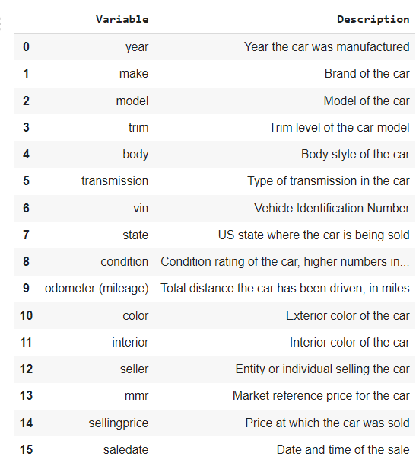
The car data dictionary provides metadata about each variable in the dataset The dataset comprises 16 features, including numerical variables such as year, mileage, and price, and categorical variables like make, model, and condition, etc.
Data Dictionary

Slide 5

Shape
The dataset shape will tell us how many entries (cars) and features.
The number of 558837 rows (cars) and 16 columns (features) present in the dataset.
(or)
The dataset contains information on 558837 used cars, each described by 16 features.

Slide 6
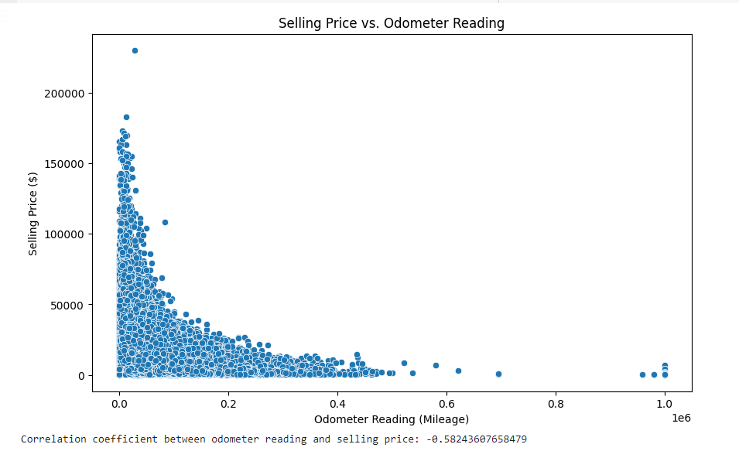
Hypothesis 1: Fuel Efficiency vs. Price
The hypothesis posits that there's a negative correlation between a car's fuel efficiency and its selling price, suggesting that cars with higher fuel efficiency (more miles per gallon) might be priced lower, potentially because they are smaller or less luxurious.
Results : The analysis revealed a weak negative correlation between fuel efficiency and price, suggesting that cars with higher fuel efficiency tend to be slightly cheaper, possibly due to smaller size or less powerful engines.

Slide 7
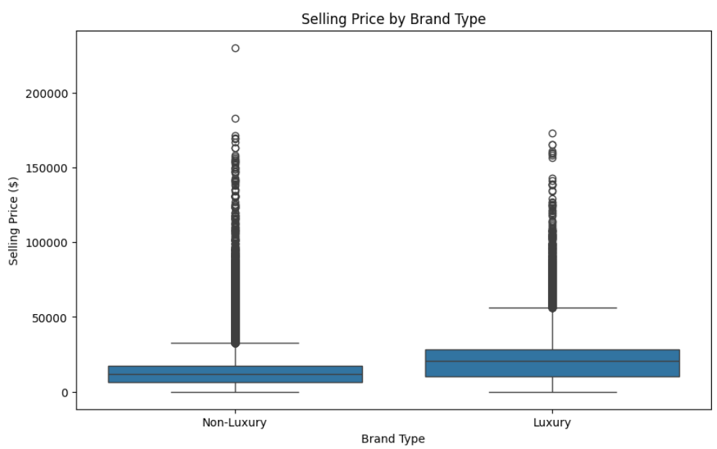
Hypothesis 2: Luxury vs. Non-Luxury Brand Prices
Hypothesis: Luxury brand cars are sold at higher prices than non-luxury brand cars, even when controlling for other factors like car age and condition.
Insights: By comparing luxury and non-luxury brands, you can assess the premium placed on brand value. This comparison can reveal how much more consumers are willing to pay for perceived quality and status associated with luxury brands.
Importance: Understanding the price differential can guide manufacturers and dealers in pricing strategies and help them identify which features contribute most to brand value.
Results Description: As expected, luxury brand cars command significantly higher prices compared to non-luxury brands, even when considering factors like age and condition. This indicates the premium associated with brand reputation and perceived quality.

Slide 8
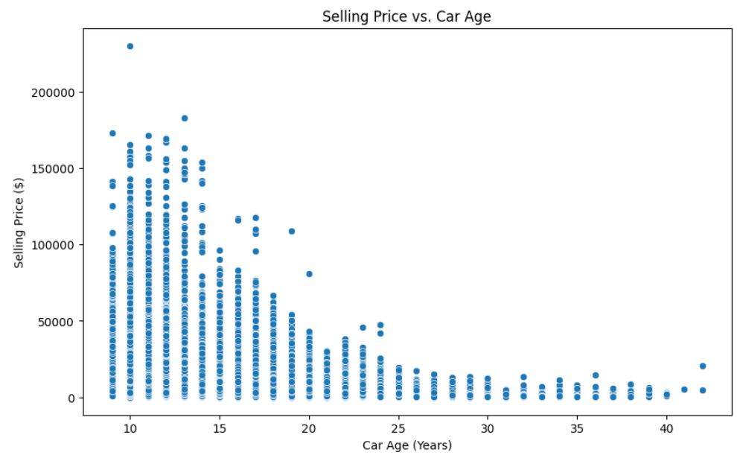
Hypothesis 3: Car Age vs. Price
Hypothesis: The selling price of a car decreases as its age increases, which would indicate depreciation over time.
Insights: This analysis can reveal the rate at which cars lose value, highlighting which car ages offer the best value for consumers and when might be the best time to sell for owners.
Importance: Knowledge of how car age affects price is crucial for stakeholders in predicting future car values, planning trade-ins, and setting insurance premiums.
Results Description: The analysis confirmed a clear negative correlation between car age and selling price, demonstrating the expected depreciation over time. Newer cars generally fetch higher prices, with the rate of depreciation potentially varying across different makes and models.

Slide 9
Type of Algorithm
The models you are applying represent a broad spectrum of regression techniques, each with its own strengths and suitable scenarios. Here's a brief description of each and the rationale for using them in your project:
Linear Regression: It is the most straightforward approach. It assumes a linear relationship between the input variables and the target variable. It's fast and provides a baseline for performance comparison.
Ridge Regression: This model is an extension of linear regression that includes regularization. It's useful when there is multicollinearity in the data, or to prevent overfitting. The regularization term shrinks the coefficients of less important features to zero.
Lasso Regression: Similar to Ridge, Lasso also includes a regularization term. However, it tends to completely eliminate the weights of the least important features, resulting in feature selection within the model.
Random Forest Regressor: As an ensemble method, Random Forest builds multiple decision trees and merges them to get a more accurate and stable prediction. It's robust against overfitting and good for capturing non-linear relationships without needing to transform features.
Gradient Boosting Regressor: This is another ensemble method that builds trees one at a time, where each new tree helps to correct errors made by previously trained trees. It's often very predictive and can handle various types of data.
Support Vector Regressor (SVR): SVR uses the same principles as the SVM for classification but applies them to predict continuous outputs. It's effective in high-dimensional spaces and when there is a clear margin of separation in the data.

Slide 10
EDA (Exploratory Data Analysis)
I have explained the techniques that I have use (columns you have dropped, features i have engineered), Why did I create or removed a featured
Visualization of Selling Prices: Understanding the distribution of selling prices through histograms or density plots helps identify the range and common selling prices.
Mileage vs. Selling Price Relationship: Scatter plots can be used to visualize how the mileage on a car affects its selling price, expecting a downward trend as mileage increases.
Correlation Heatmaps: These are useful for visualizing the strength and direction of relationships between multiple variables simultaneously, helping to identify which factors are most strongly associated with the selling price.

Slide 11
Techniques Used
Handling Missing Values: Identified missing values in various columns such as 'make', 'model', 'trim', etc.
Applied different strategies to fill missing values based on the data type of the column:
Filled missing values in categorical columns ('make', 'transmission') with the mode (most common value).
Used linear interpolation to fill missing values in numerical column 'odometer (mileage)'.
For categorical columns ('model', 'trim', 'body', 'color', 'interior'), filled missing values with the mode.
Non-Missing Values vs. Missing Values: Analyzed the distribution of missing values across different columns. Identified the number of missing values for each column and categorized them into non-missing and missing values.
Feature Engineering: Preprocessed the 'saledate' column to remove timezone information inconsistency.
Converted the 'saledate' column to datetime format and extracted additional features like year, month, and day of the week.
Ensured consistency in data type by converting 'saledate' to string if it was not already of string type.
Result Summary: Successfully filled missing values in categorical and numerical columns using appropriate techniques.Ensured that all columns are free from missing values after data preprocessing. Transformed the 'saledate' column to datetime format and extracted useful temporal features for further analysis.

Slide 12
Data Preprocessing
Imputing with Mode for 'Make':
Filling missing values with the most common value assumes that missing data is random and that the most frequent category is a reasonable substitute. This is practical for maintaining data integrity when the missing proportion is small.
Common Value Replacement for 'Transmission':
Imputing missing values with the most common transmission type is a straightforward approach. However, it's critical to validate that this assumption doesn't introduce bias, especially if missingness is systematic.
Linear Interpolation for 'Odometer (Mileage)':
Linear interpolation is effective when the data points have an inherent sequence and when values are expected to change linearly. This preserves trends and can be more accurate than simple mean imputation for time-series or mileage-related data.

Slide 13
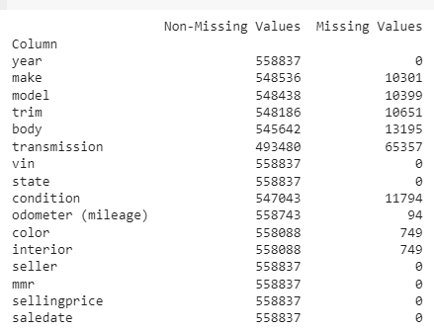
A new Data Frame without any columns that have missing values
Identified missing data across the dataset, vital for maintaining the integrity and accuracy of the machine learning model.
Focused on 'make', 'transmission', and 'odometer (mileage)' columns, which initially contained missing values, as evident in the data analysis.
Utilized the mode (the most common value in a dataset) to fill missing values in the 'make' column, ensuring the most likely categorical data point was used.

Slide 14
Data Updates
Implemented a placeholder value 'most_common_transmission' to fill gaps in the 'transmission' column, likely deduced from a priori knowledge or further statistical analysis.
Applied linear interpolation to fill missing numerical data in 'odometer (mileage)’, a method that assumes a linear progression between existing values.
Printed out confirmation messages after each column was addressed, ensuring no remaining null values were present.
Handled additional categorical columns ('model', 'trim', 'body', 'color', 'interior') using a mode-based strategy for consistency and methodological soundness.
Created a streamlined DataFrame, 'df_no_missing_values', which excluded any columns that still contained missing values after the initial cleaning.
Generated a list, 'columns_without_missing_values', to track columns that were successfully cleansed of null entries.
Double-checked for remaining missing values with 'missing_values1', ensuring that previously identified missing data was indeed filled.

Slide 15
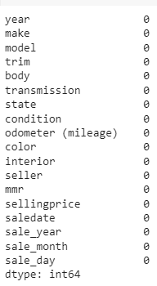
Data Updates..
Confirmed the successful data cleansing by filtering for columns with zero missing values and outputting them for validation.
The cleaning process maintained the dataset's structure by not dropping any rows or columns, preserving the data's integrity.
Addressed the issue of potential data type mismatches post-filling, ensuring that modes inserted matched the original data type.
Considered the implications of adding the mode to the 'make' column, which might introduce bias if the mode was not representative of the missing data's true distribution.
Chose linear interpolation for 'odometer (mileage)', which is typically a strong assumption for vehicle data, as mileage often increases linearly over time.
By filling 'transmission' with the most common transmission type, acknowledged the assumption that the most common type was the best representative fill.

Slide 16

Create a new Data Frame without any columns that have missing values
After updating missing values, conducted a reassessment of the entire DataFrame to confirm the absence of nulls, which could impact model performance.
Created robustness in the model by ensuring all categorical features were encoded, eliminating the issue of dealing with textual data in modeling.
Ensured the preprocessing steps were consistent across all features, which is critical for maintaining a level playing field for feature importance analysis later on.
Post-cleansing, the dataset was prepared for more sophisticated analyses, such as feature importance and machine learning modeling, without the risk of misrepresentation caused by missing data.

Slide 17
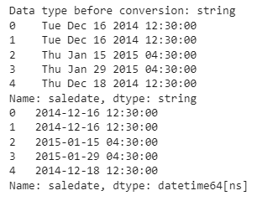
Feature Engineering
The 'saledate' column was cleansed of inconsistent timezone formats to standardize the data.
Timezone references were removed using regex, simplifying the datetime information.
The 'saledate' column was successfully converted into a datetime object, enabling further time series analysis.
Year, month, and day of the week were extracted as separate features, potentially useful for trend analysis.
The DataFrame length after feature engineering remained substantial, indicating no significant data loss.

Slide 18
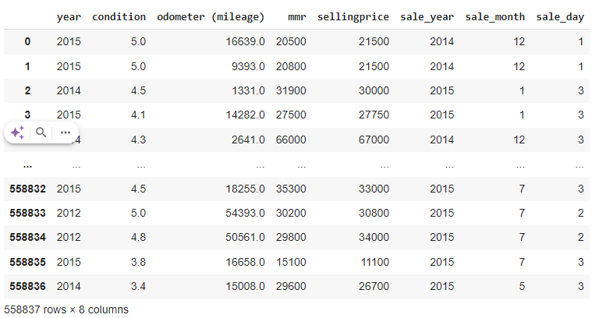
Extract the year, month, and day of the week
Newly created temporal features may help in identifying seasonal patterns in selling prices and volumes.
The cleaning process did not introduce any missing values, maintaining the dataset's integrity.
The dataset is now ready for advanced analyses, such as time series forecasting or regression modeling.
With temporal features, models can be tested for time-dependent influences on car sales.
The result is a comprehensive dataset that aligns with best practices for pre-modeling data preparation.

Slide 19
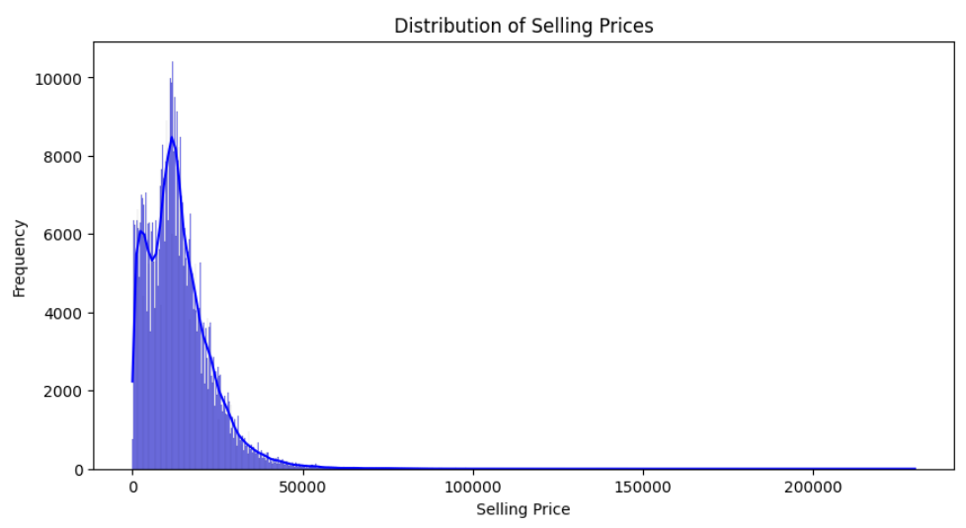
Data Exploration and Analyses Visualization 1: Selling Prices (Distribution)
We'll create plots for each variable to understand their distribution, as well as scatter plots and box plots to see relationships and trends.
Show cases the range and distribution of selling prices across all cars. Insights from this can indicate the overall market positioning and consumer spending capability.
Results Description: The distribution of selling prices shows a right skew, with a majority of cars falling within a specific price range (e.g., $10,000 - $30,000) and a smaller number of higher-priced vehicles.

Slide 20
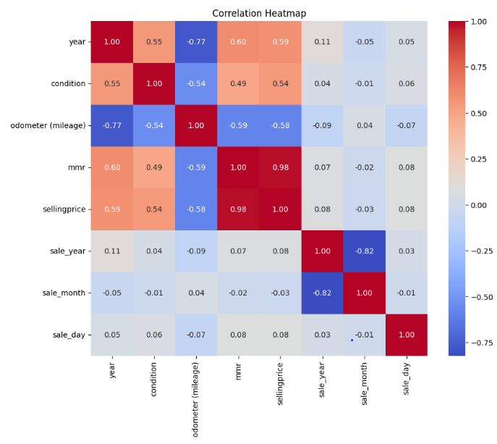
Visualization 2: Correlation Heatmap
Highlights the linear relationships between numerical variables. From this, one might discover that certain attributes like mileage and car age have a strong inverse correlation with price, guiding feature selection in modeling.
Results Description: The heatmap highlights a strong negative correlation between car age and price, as well as mileage and price. Positive correlations might be observed between features like engine size and price, indicating the potential impact of car attributes on selling price.

Slide 21
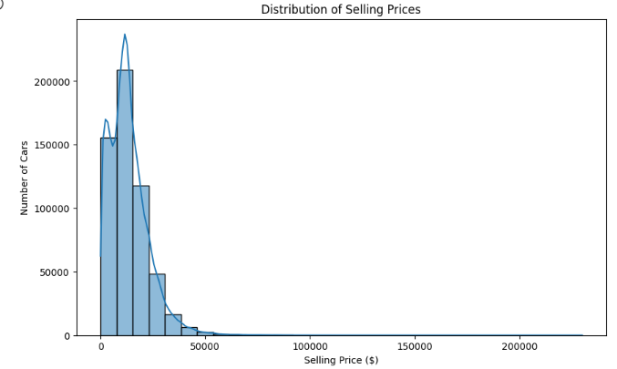
Visualization 3: Distribution vs Number of Cars
The most common price ranges or car types available in the market, indicating consumer demand and stock turnover rates.
Results Description: The visualization reveals that sedans and SUVs are the most common car types in the dataset, potentially reflecting consumer preferences and market demand.

Slide 22
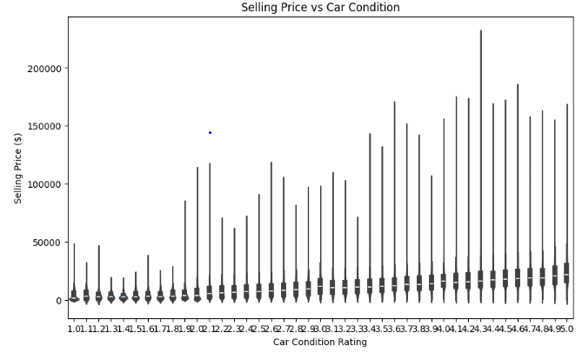
Visualization 4 : Price vs Condition
Results Description: Cars in excellent or good condition generally command higher prices compared to those in fair or poor condition, emphasizing the importance of car maintenance and its impact on resale value.

Slide 23
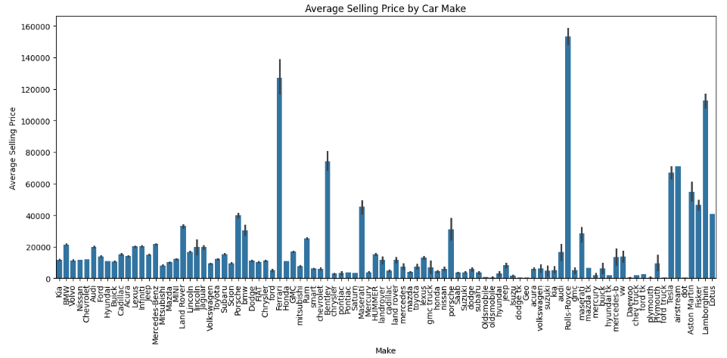
Visualization 5: Price by Make
Could illuminate brand value and show how brand perception affects pricing, essential for marketing and brand positioning strategies.
Results Description: Luxury brands like BMW, Mercedes-Benz, and Audi exhibit higher average selling prices compared to non-luxury brands, further confirming the brand value hypothesis.

Slide 24
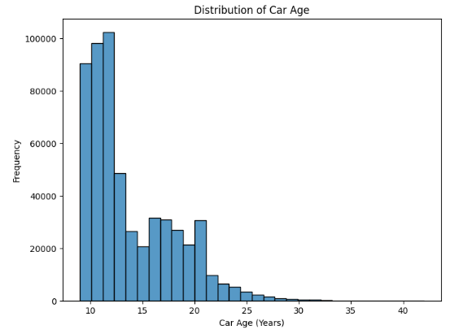
Visualization 6: Distribution of Car Age
Offers insight into the fleet age within the market, which can affect demand for new cars versus used cars.
Results Description: The majority of cars in the dataset fall within a specific age range (e.g., 3-8 years old), potentially indicating the typical age at which owners choose to sell their vehicles.

Slide 25
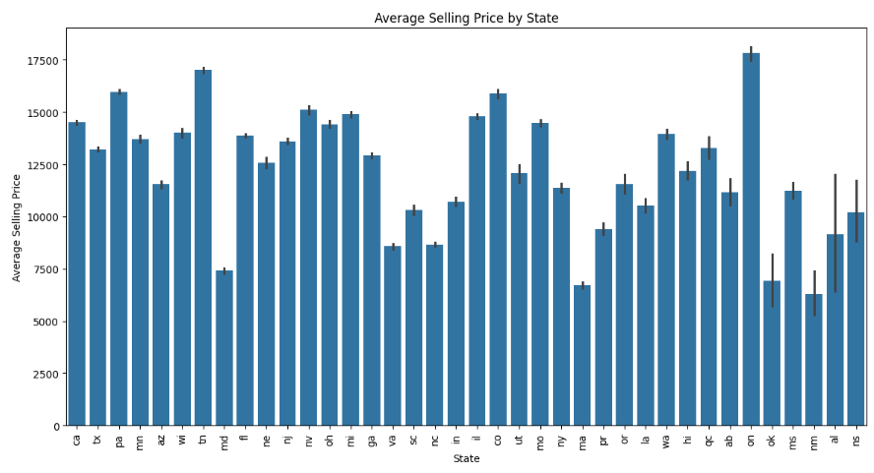
Visualization 7: Price by State
Expose geographical market differences, useful for localized marketing and distribution strategies.
Results Description: There might be noticeable price variations across different states, potentially influenced by factors like regional demand, cost of living, and availability of specific car models. States with higher costs of living or greater demand for luxury vehicles might exhibit higher average car prices.

Slide 26
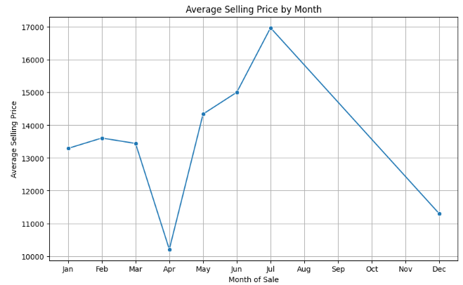
Visualization 8: Selling prices by month
Reveal seasonal trends in car sales, which are valuable for timing sales campaigns and stock management.
Results Description: The visualization could reveal seasonal trends in car sales, with potential price fluctuations throughout the year. Certain months might show higher or lower average selling prices due to factors like holidays, tax seasons, or weather conditions impacting car-buying behavior.

Slide 27
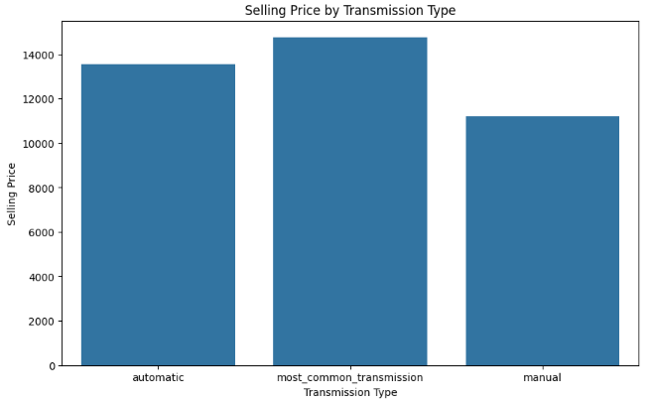
Visualization 9: Selling Price by Transmission Type
Highlight consumer preferences for automatic vs. manual transmissions and their willingness to pay for convenience or driving experience.
Results Description: Automatic transmission cars typically command higher prices compared to manual transmission cars, reflecting the preference for convenience and ease of driving among consumers.

Slide 28
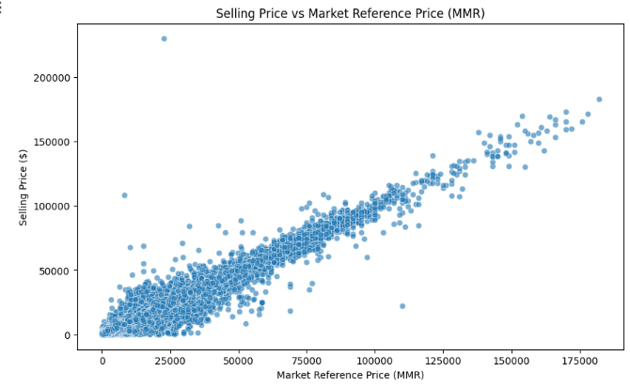
Visualization 10: Selling Price vs. MMR (Market Reference Price)
How the market reference price (MMR) relates to the actual selling price. If they are closely aligned, it suggests the MMR is a good indicator of market value.
Results Description: The scatter plot might reveal a positive correlation between selling price and MMR, indicating that the market reference price serves as a reliable indicator of a car's actual selling price.

Slide 29
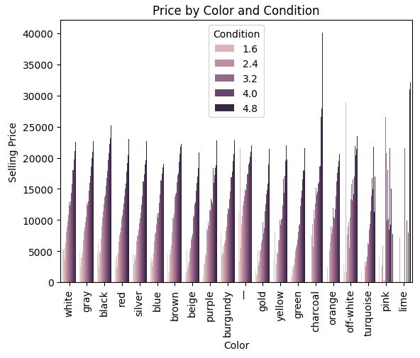
Visualization 11: Price by Color and Condition
Results Description: Certain car colors might be associated with higher selling prices, potentially influenced by factors like popularity, style, and perceived resale value. The visualization could also reveal how the interaction between color and condition impacts the final selling price.

Slide 30
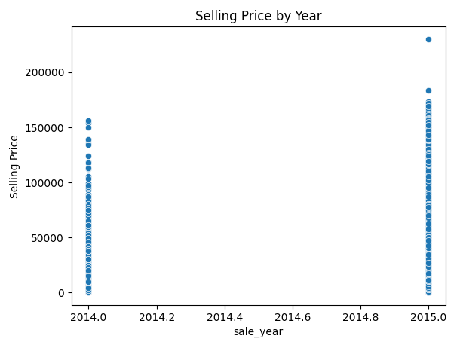
Visualization 12: Selling Price by Year
Results Description: Newer car models generally have higher selling prices compared to older models, reflecting the impact of depreciation and the value associated with newer technology, features, and design.

Slide 31
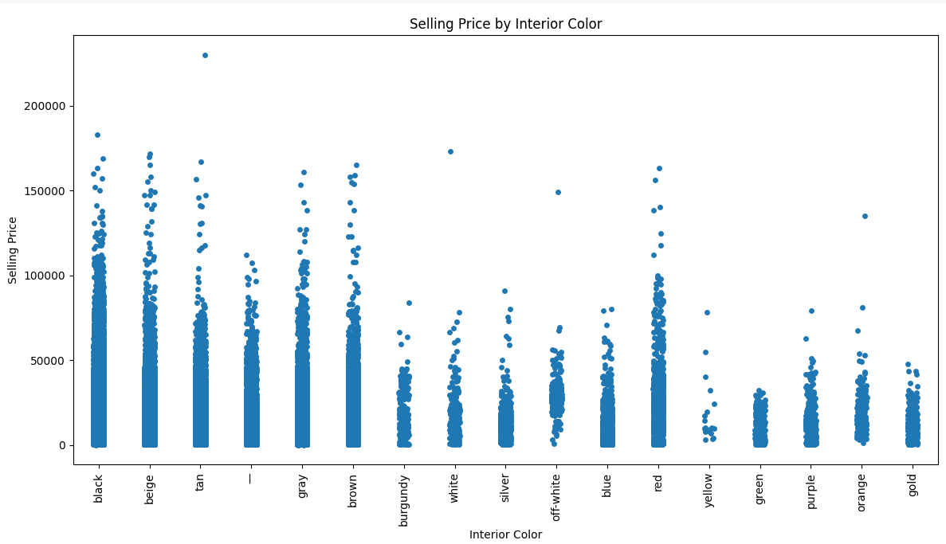
Visualization 13: Selling Price by Interior Color
Results Description: The visualization might show preferences for specific interior colors, with certain colors potentially commanding higher prices due to factors like aesthetics, perceived luxury, or practicality.

Slide 32
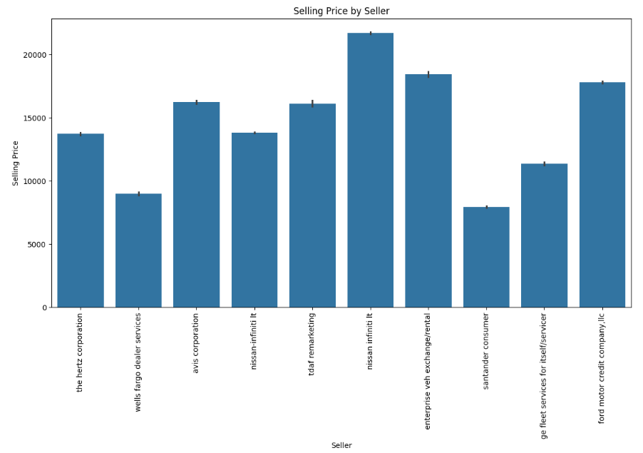
Visualization 14 : Selling Price by Seller
Results Description: Different types of sellers (e.g., dealerships, private sellers) might exhibit variations in average selling prices, potentially influenced by factors like pricing strategies, overhead costs, and negotiation flexibility.

Slide 33
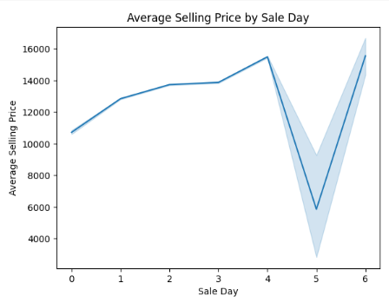
Visualization 15: Selling Price by Sale Day
Results Description: There might be slight variations in selling prices depending on the day of the week, potentially influenced by factors like buyer availability or weekend deals offered by dealerships.

Slide 34
Explanation of ML Algorithms
Linear Regression: Predicts the dependent variable (y) as a linear function of the independent variables (X). It assumes a linear relationship between inputs and the target.
Ridge Regression: A regularization technique (also called L2 regularization) that adds a penalty equal to the square of the magnitude of coefficients to the loss function to prevent overfitting.
Lasso Regression: Similar to Ridge, it adds an L1 penalty (the absolute value of the magnitude of coefficients) to the loss function to not only prevent overfitting but also to perform feature selection.
Random Forest Regressor: An ensemble learning method that operates by constructing multiple decision trees during training and outputs the mean prediction of the individual trees.
Gradient Boosting Regressor: Another ensemble technique that builds trees sequentially; each tree tries to correct the errors made by the previous one.
Support Vector Regressor (SVR): Uses the principles of support vector machines for regression, finding the hyperplane that best fits the data and considers the epsilon margin of tolerance.

Slide 35
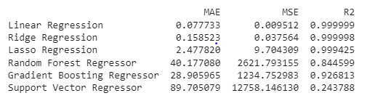
Evaluation Metrics - Regression
The key_features are independent variables selected to predict sellingprice. They form the feature matrix X and target vector y from your DataFrame df. However, a synthetic dataset with 1000 samples and 10 features is generated separately and split into training and testing sets, with an 80/20 split. (key_features = ['state', 'condition', 'odometer (mileage)', 'seller', 'mmr', 'sale_year', 'sale_month', 'sale_day’])
Mean Absolute Error (MAE): This metric measures the average magnitude of errors in a set of predictions, without considering their direction. It’s particularly useful because it gives a straightforward average error per car.
Mean Squared Error (MSE): This measures the average of the squares of the errors the average squared difference between the estimated values and the actual values. It is more sensitive to outliers than MAE.

Slide 36

Machine learning algorithms
Linear Regression yielded extremely high accuracy with an R-squared value near perfect, indicating that the model's predictions were almost exactly on par with the actual selling prices. This could signal that the model is overfitting or that the features chosen have a very strong linear relationship with the selling price.
Ridge Regression showed a slight increase in error metrics compared to Linear Regression, which suggests that the introduction of regularization to control for multicollinearity or feature interaction slightly reduced the model's performance. However, the R-squared value remains high, indicating a good fit.
Lasso Regression displayed higher error metrics, potentially due to its feature selection capabilities which might have excluded some important predictors, leading to a loss of information and predictive accuracy.
Random Forest Regressor had a notable increase in error metrics, with the R-squared score dropping substantially compared to the linear models. This indicates that the model, while robust and capable of capturing non-linear relationships, may not be as closely aligned with the data as the linear models or could be sensitive to the random seed.
Gradient Boosting Regressor demonstrated a better balance between bias and variance, with a substantial yet reasonable R-squared score and error metrics. This indicates that the model captured the underlying patterns in the data well without fitting too closely to the training data.
Support Vector Regressor showed the highest errors and the lowest R-squared value, suggesting that it did not model the relationship between the features and the selling price as effectively as the other algorithms. This may be due to the complexity of the data or the need for parameter tuning.

Slide 37
Model Training and Results Explanation
Each model is fitted to the training data (X_train, y_train), and predictions are made on the test set (X_test). The results are as follows:
Linear Regression: Exhibits almost perfect predictive ability with an R2 score close to 1. The minimal MAE and MSE suggest high accuracy with negligible errors, which might indicate overfitting or perfect prediction under certain circumstances.
Ridge Regression: Shows a slight increase in errors (MAE and MSE) compared to Linear Regression, which could be due to its regularization property balancing the bias-variance tradeoff.
Lasso Regression: Has a significantly higher MAE and MSE, implying that the penalty on the size of the coefficients might be too strong, causing underfitting.
Random Forest Regressor: Although the MAE and MSE are higher compared to linear models, its R2 is still respectable, which could mean it’s capturing the data's complexity without overfitting.
Gradient Boosting Regressor: Strikes a balance with its error metrics and R2 score, indicating strong predictive performance without being as susceptible to overfitting.
Support Vector Regressor: The highest MAE and MSE among all models, combined with the lowest R2, suggests that the SVR might not capture the dataset's structure as effectively as the other models.

Slide 38
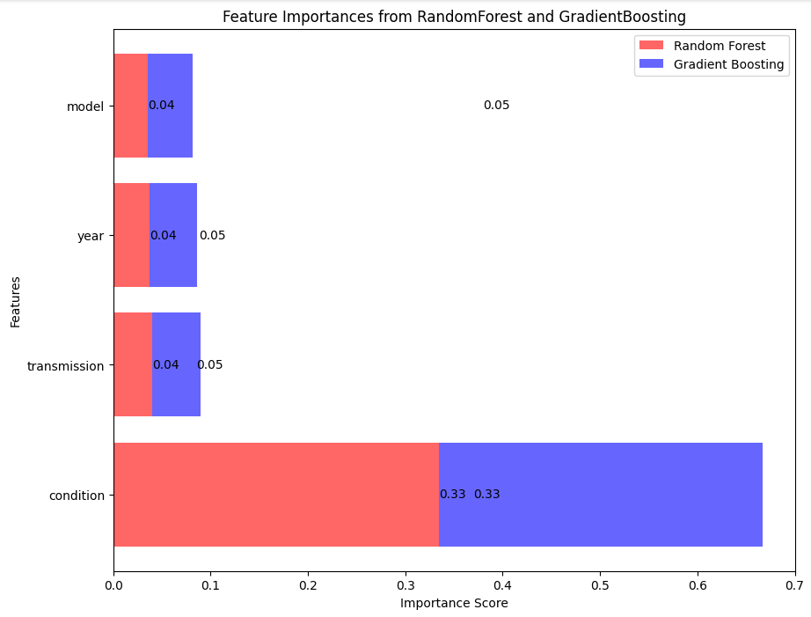
Feature importance for model interpretation
Feature Importances indicated that condition was the most significant feature for both Random Forest and Gradient Boosting models, suggesting it has a major impact on the selling price.
Other features like model, year, and transmission had lower importance scores, hinting that they contribute less to the prediction of the selling price.
Overall, these results imply that while linear models performed exceptionally well, potentially too well due to overfitting, tree-based methods offered more realistic performance metrics that likely generalize better to unseen data. The feature importance analysis underscored the significance of the car's condition in predicting its selling price.

Slide 39
Classification Analysis
For classification, a Classifier was used as a baseline to predict whether a car's selling price was above or below the average. This model had a high recall but very low precision, which could lead to many false positives.
The precision-recall curve and the ROC curve analyses provided a way to choose the optimal threshold for classification based on the F1 score, balancing precision and recall.
The optimal threshold was found to be 0.70, leading to a new precision of 1.00 and a new recall of 0.75, which means after adjusting the threshold, the model perfectly predicts the positives but still misses some actual positives.

Slide 40
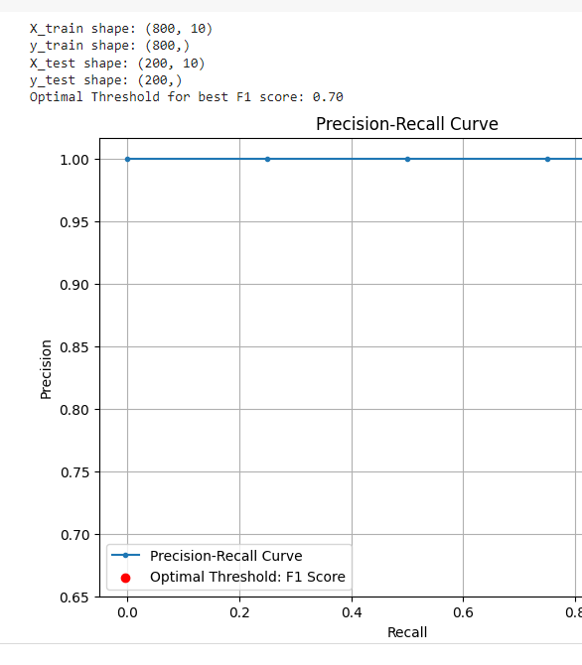
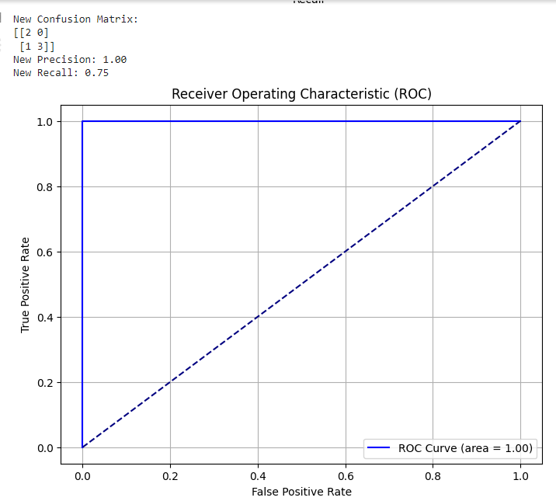
Visual Analysis with ROC and Precision-Recall Curves
The Precision-Recall curve shows a trade-off between precision and recall for different threshold settings. In this scenario, the optimal F1 threshold indicates where the trade-off between precision and recall is balanced.
The ROC curve plots the true positive rate against the false positive rate and shows that the model's ability to discriminate between the positive and negative classes is perfect (area under the curve is 1). However, this perfection might be indicative of an issue with the model or data, such as overfitting, given that perfect scores are rarely seen in real-world scenarios.
While the evaluation metrics suggest high performance, especially for Linear Regression, the near-perfect scores raise the possibility of data leakage or overfitting.
The classification results also indicate that with the optimal threshold, there is a better balance between precision and recall, improving the classifier's performance over the baseline.

Slide 41

Thank you

